Slide 1
The structure of a first conditional sentence
A first conditional sentence consists of two clauses, an "if" clause and a main clause:
if clause | main clause
If you study hard, | you will pass the test.
If the "if" clause comes first, a comma is usually used. If the "if" clause comes second, there is no need for a comma:
main clause | if clause
You will pass the test | if you study hard.

Slide 2
The structure and use of a first conditional sentence
We use different verb forms in each part of a first conditional:
if clause | if + subject + simple present verb
main clause | subject + will + verb
The first conditional is used to talk about things which are possible in the present or the future -- things which may happen:
Example | Explanation
If it's sunny, we'll go to the park. | Maybe it will be sunny -- that's possible.
Paula will be sad if Juan leaves. | Maybe Juan will leave -- that's possible.
If you cook the supper, I'll wash the dishes. | Maybe you will cook the supper -- that's possible.

Slide 3
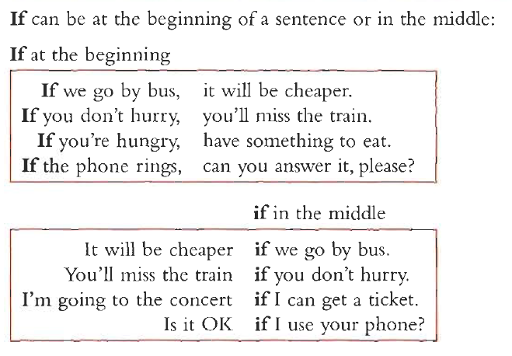
won’t

Slide 4
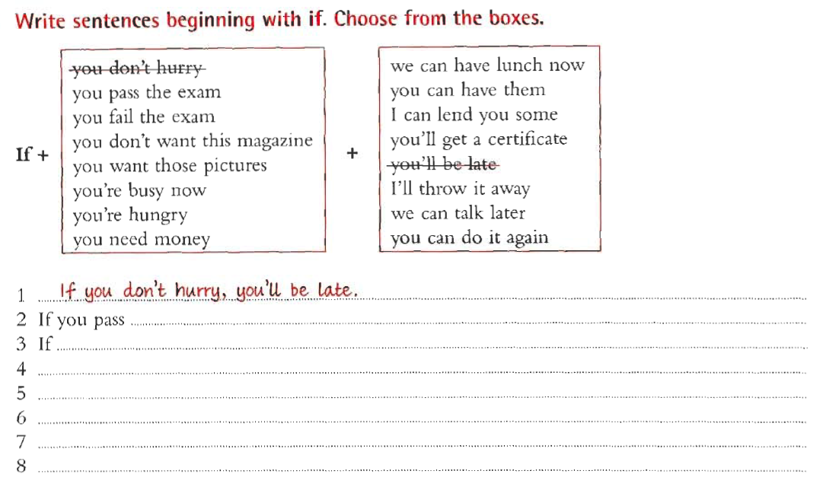

Slide 5
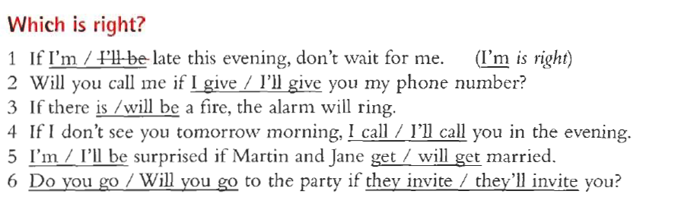
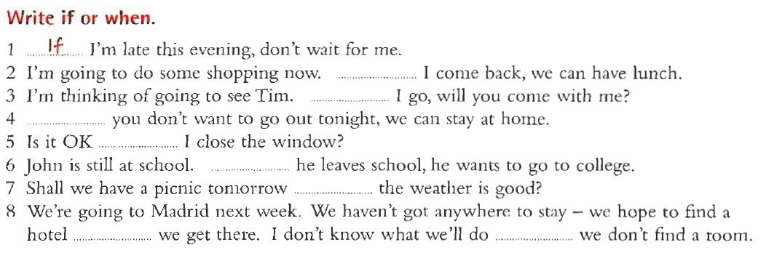

Slide 6
CONDITIONALS
Conditional Sentences Type 2
→ There is an unreal possibility that the condition will happen.
→ Form: if + Past Simple, would (Conditional)
could
→ Examples:
- If you did your homework more often, your teacher wouldn´t get angry with you.
- If they left early, they would get to the theatre on time.

Slide 7
Match the sentence halves.
1 If I did more sport,
2 I'd be really happy if
3 If I could sing,
4 My parents would be really angry if
5 If I studied harder,
6 If I had a lot of money,
7 If I could drive,
A I had a party without telling them .
B I'd get much fitter.
C I'd go to South America.
D my father bought me a motorbike.
E I'd be in a band.
F I'd go to the coast more often.
G I'd speak better English.

Slide 8
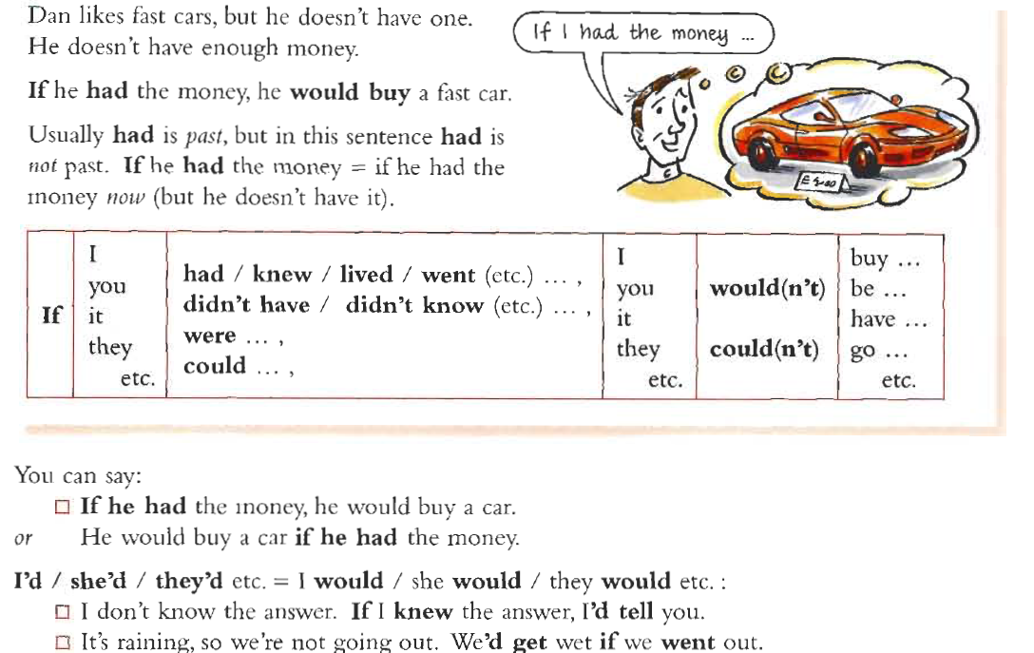

Slide 9
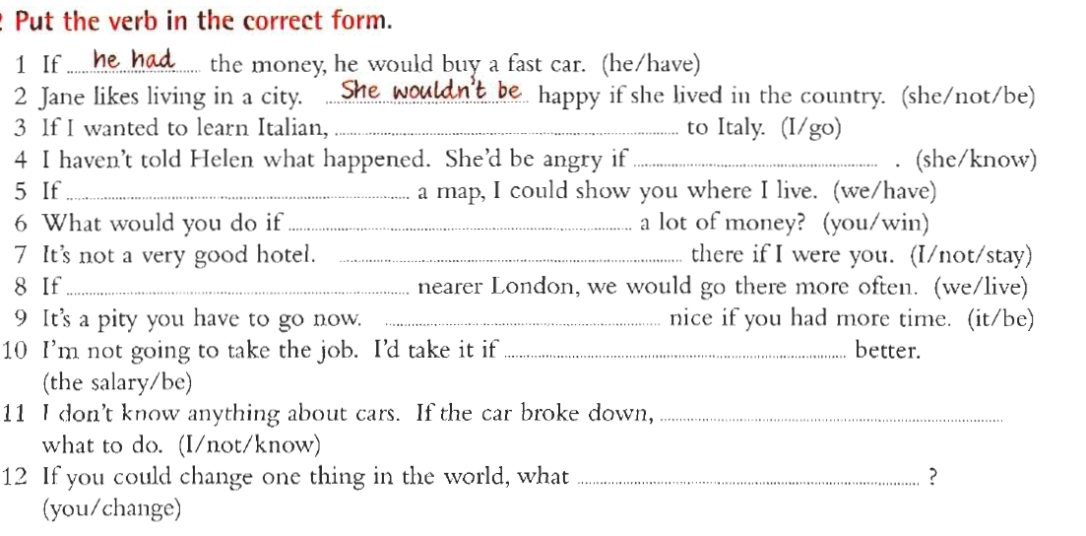

Slide 10
